Slide 1
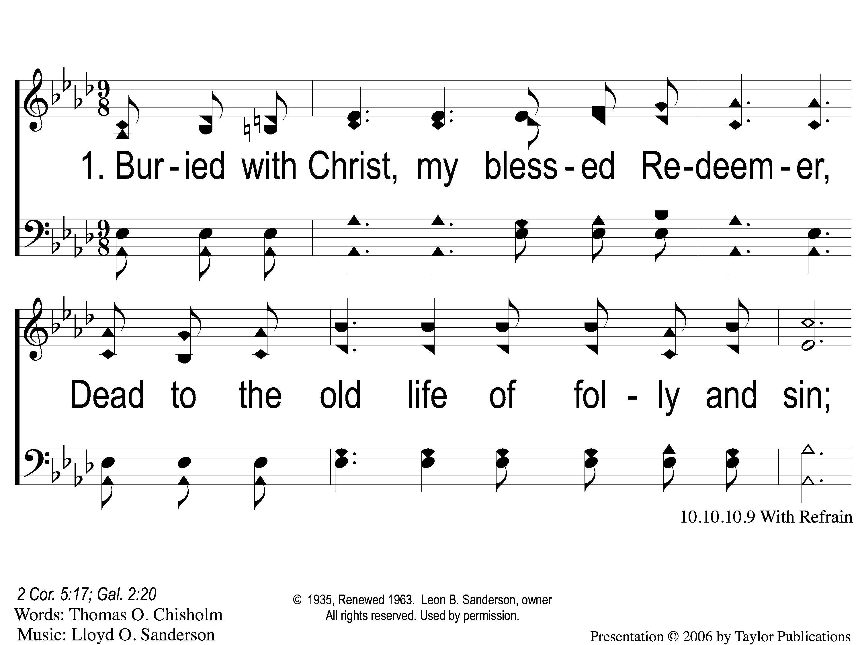
1-1 A New Creature
A New Creature
619

Slide 2
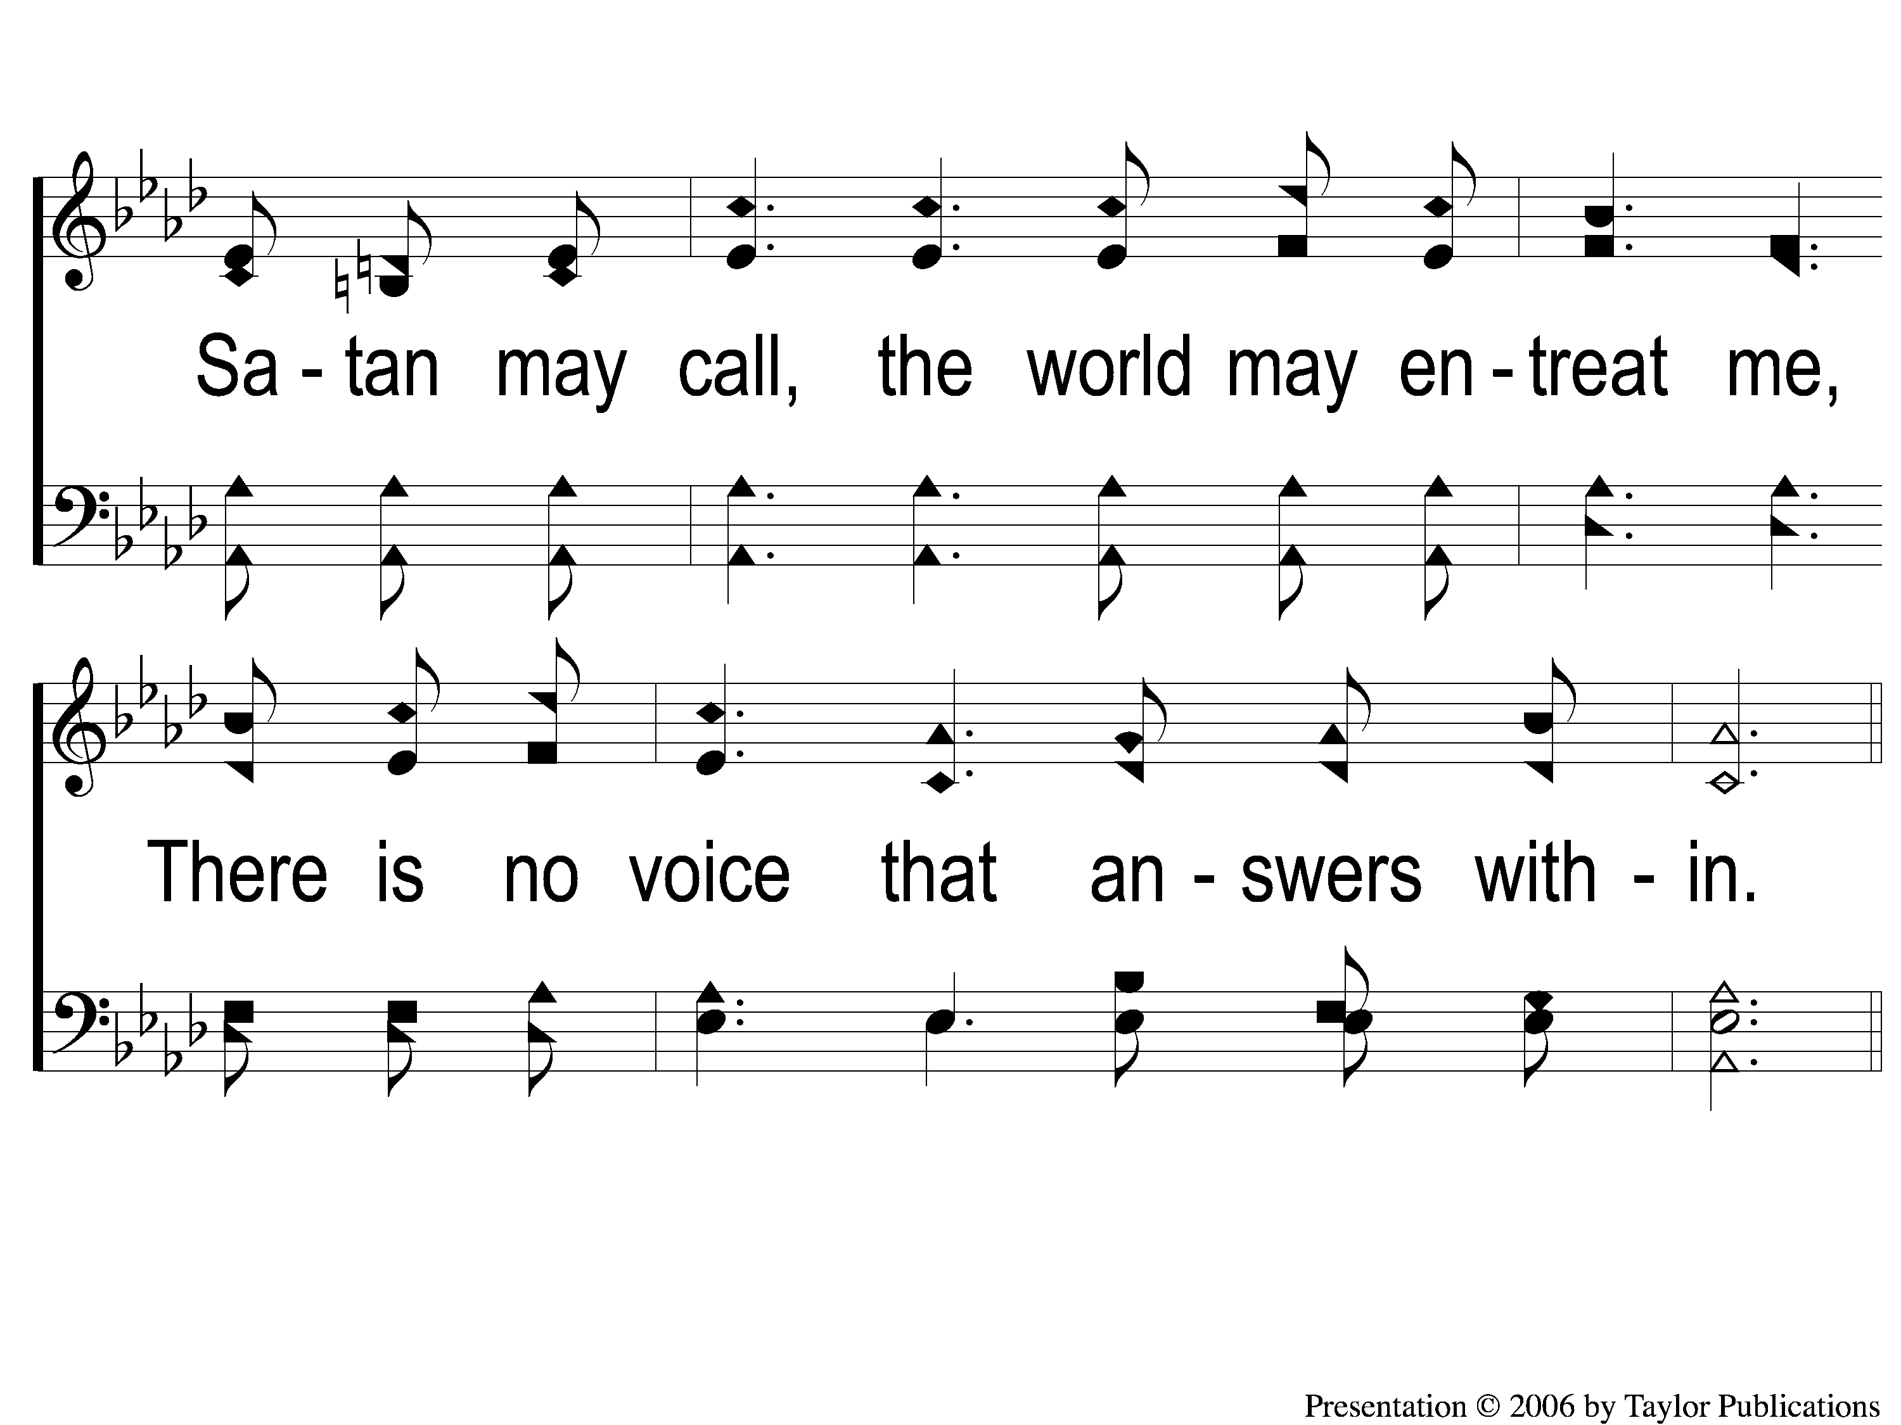
1-2 A New Creature
A New Creature
619

Slide 3
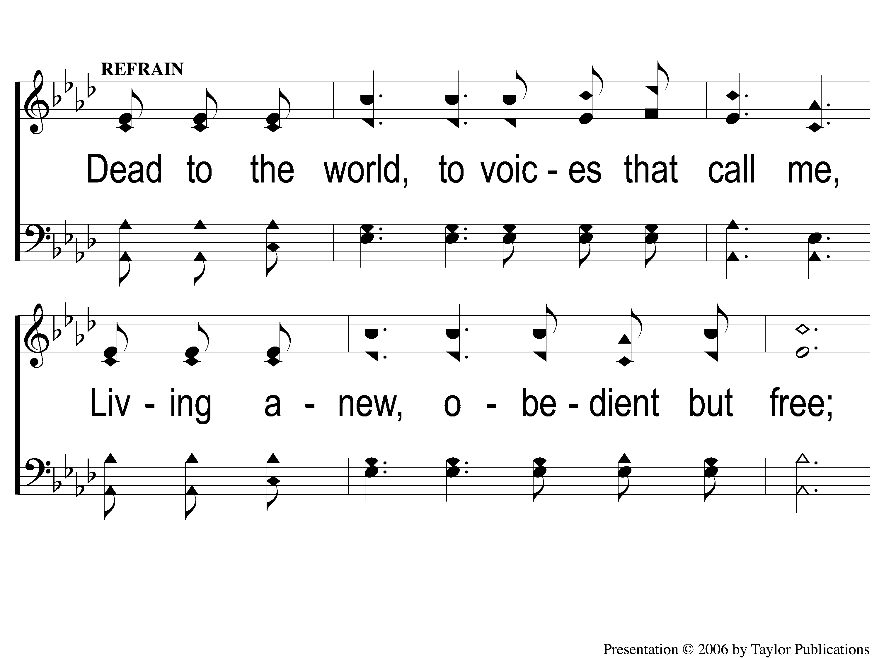
C-1 A New Creature
A New Creature
619

Slide 4
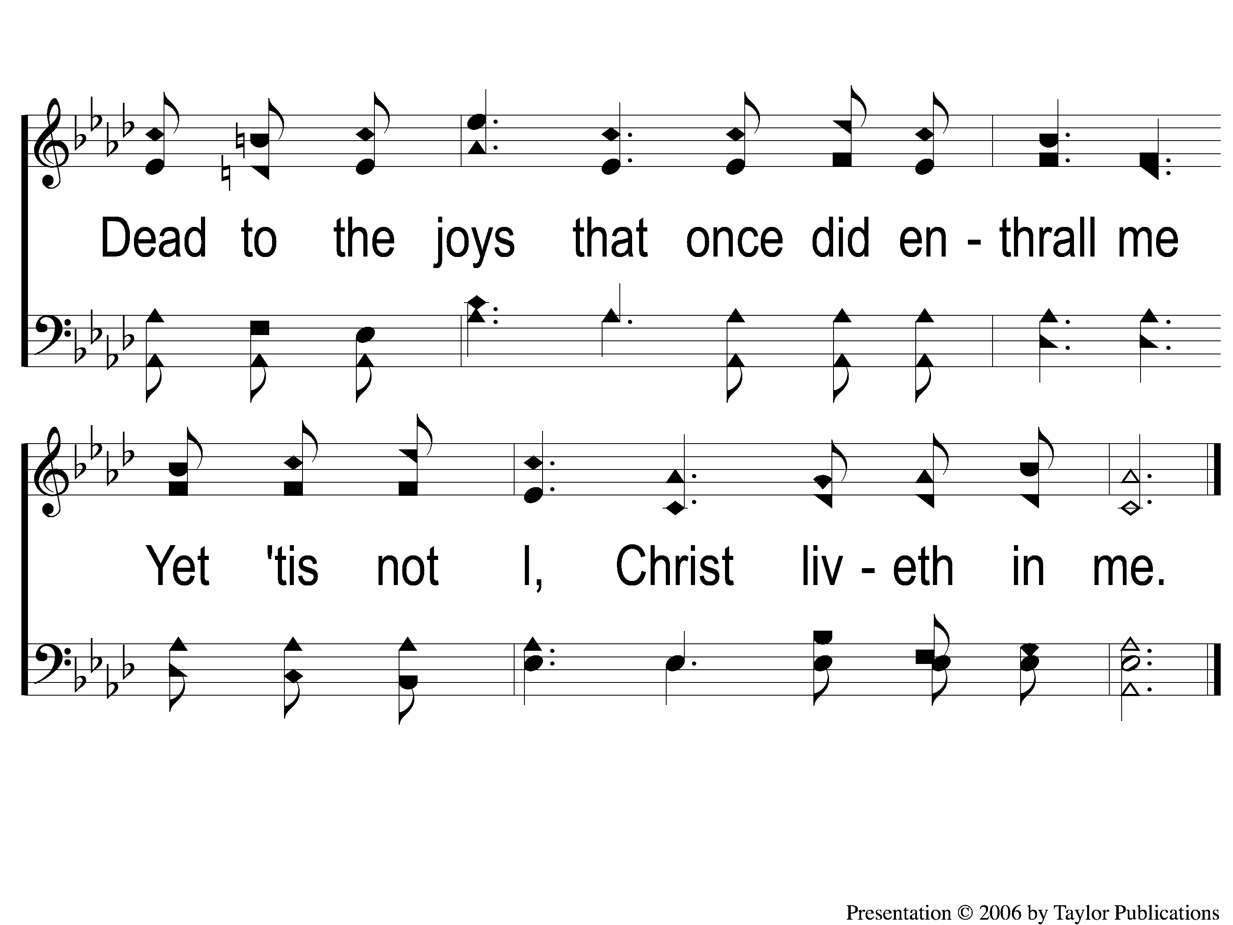
C-2 A New Creature
A New Creature
619

Slide 5
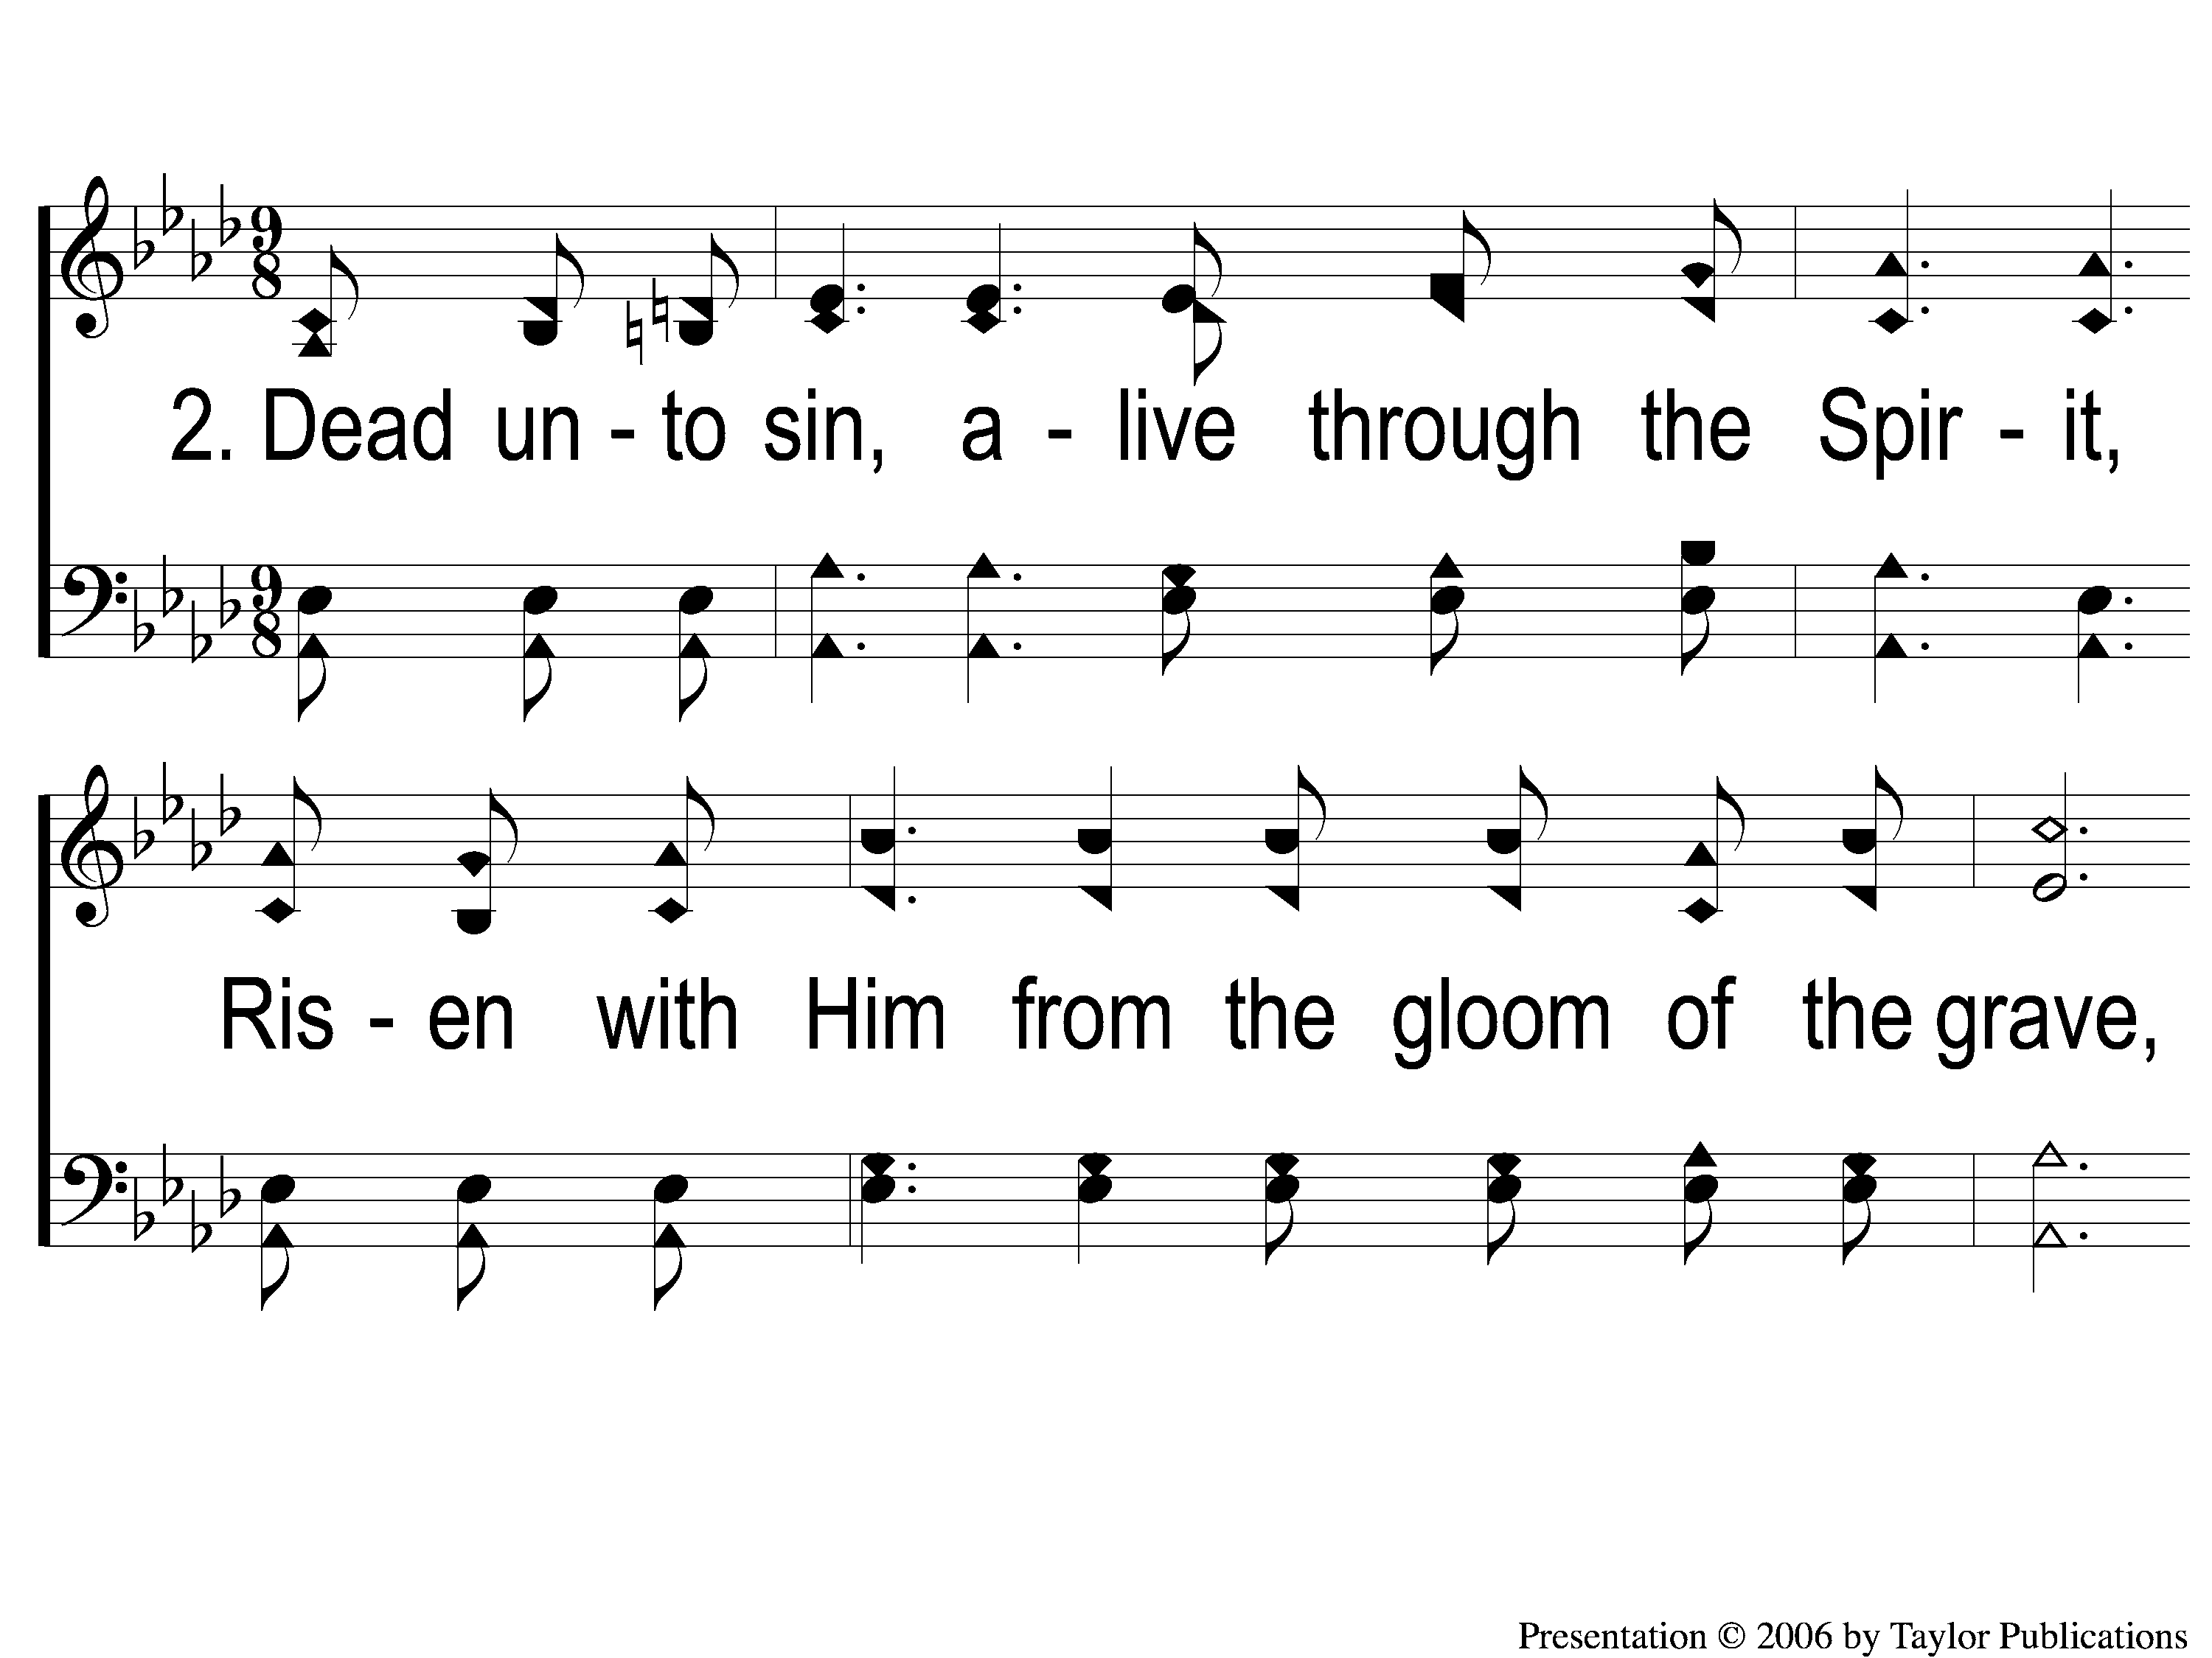
2-1 A New Creature
A New Creature
619

Slide 6
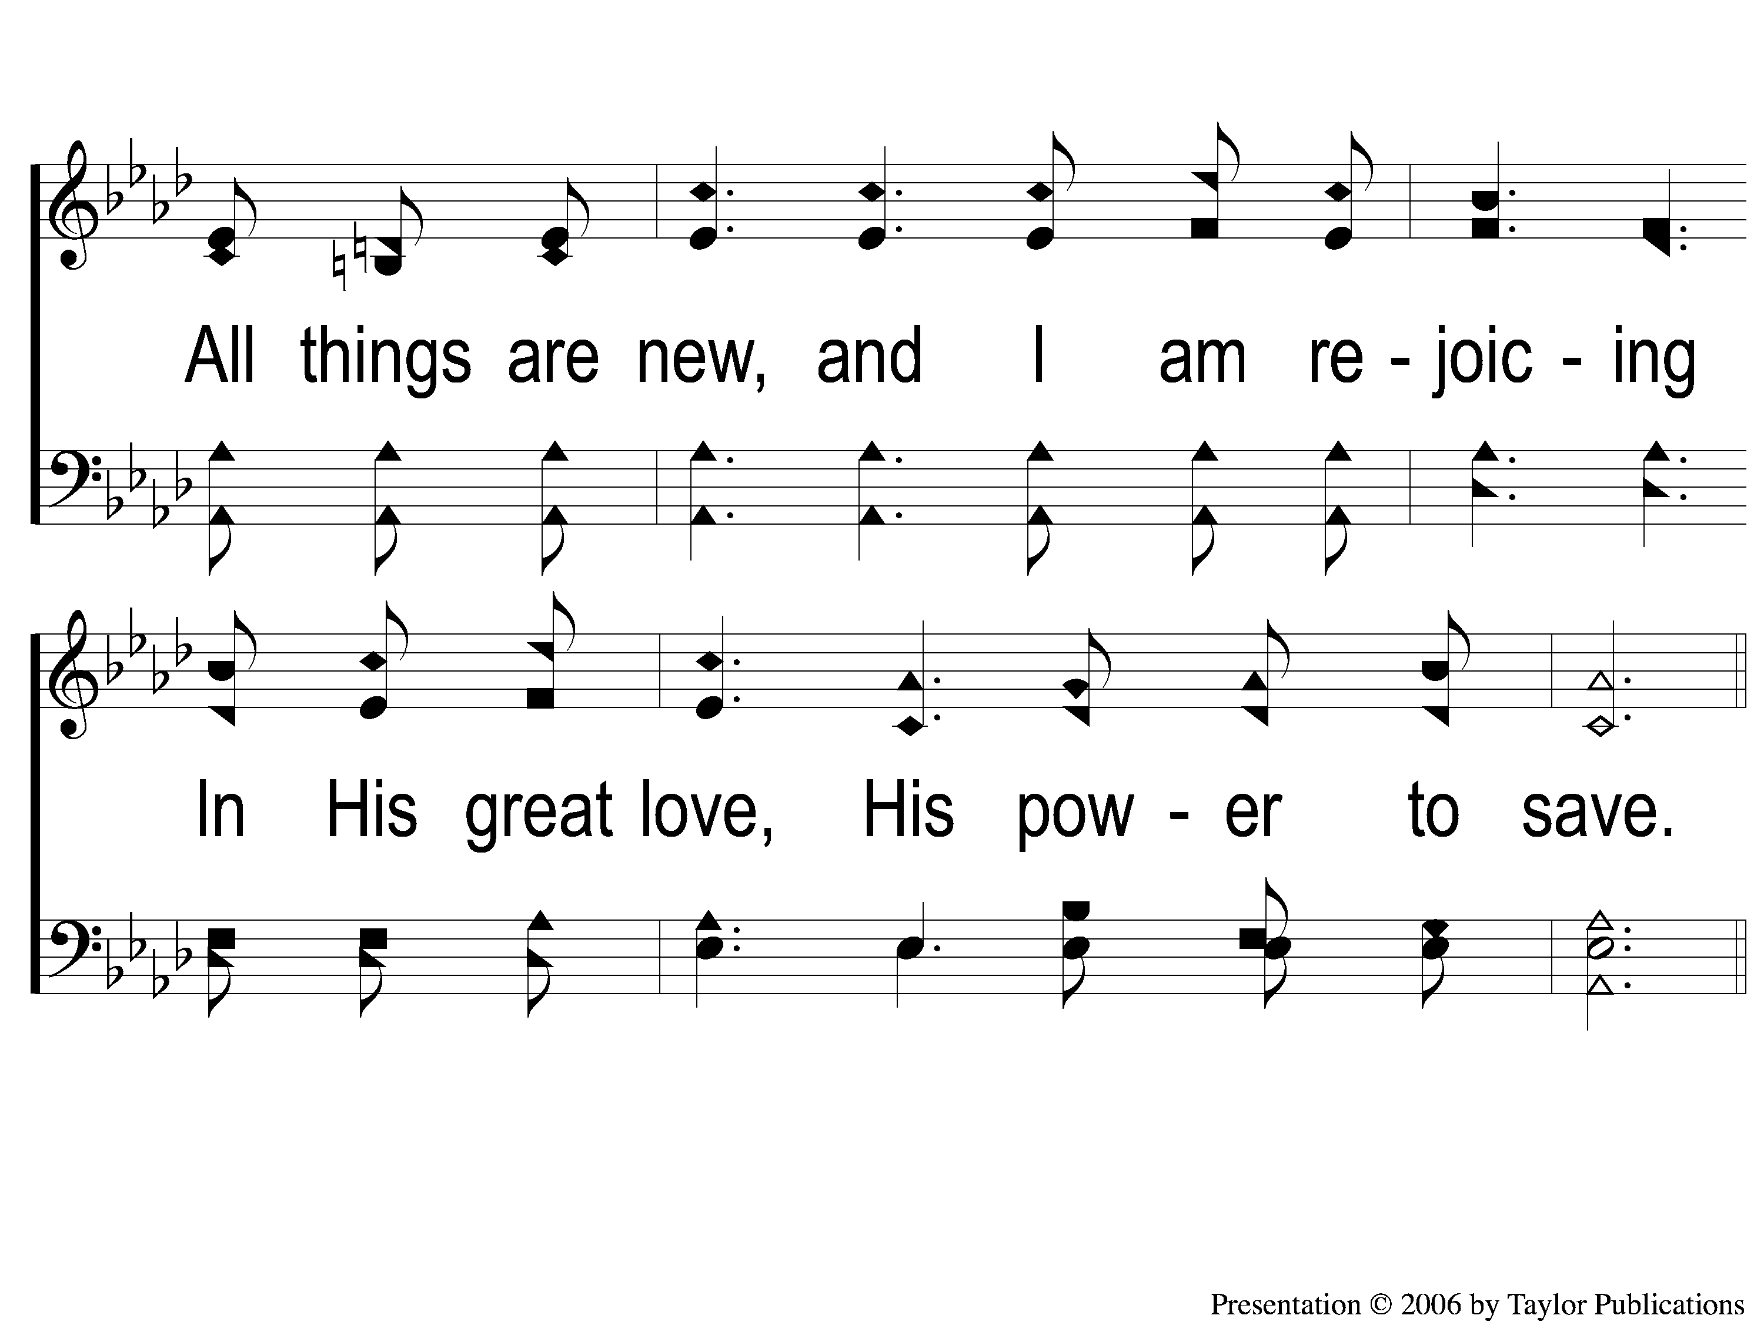
2-2 A New Creature
A New Creature
619

Slide 7
C-1 A New Creature
A New Creature
619

Slide 8
C-2 A New Creature
A New Creature
619

Slide 9
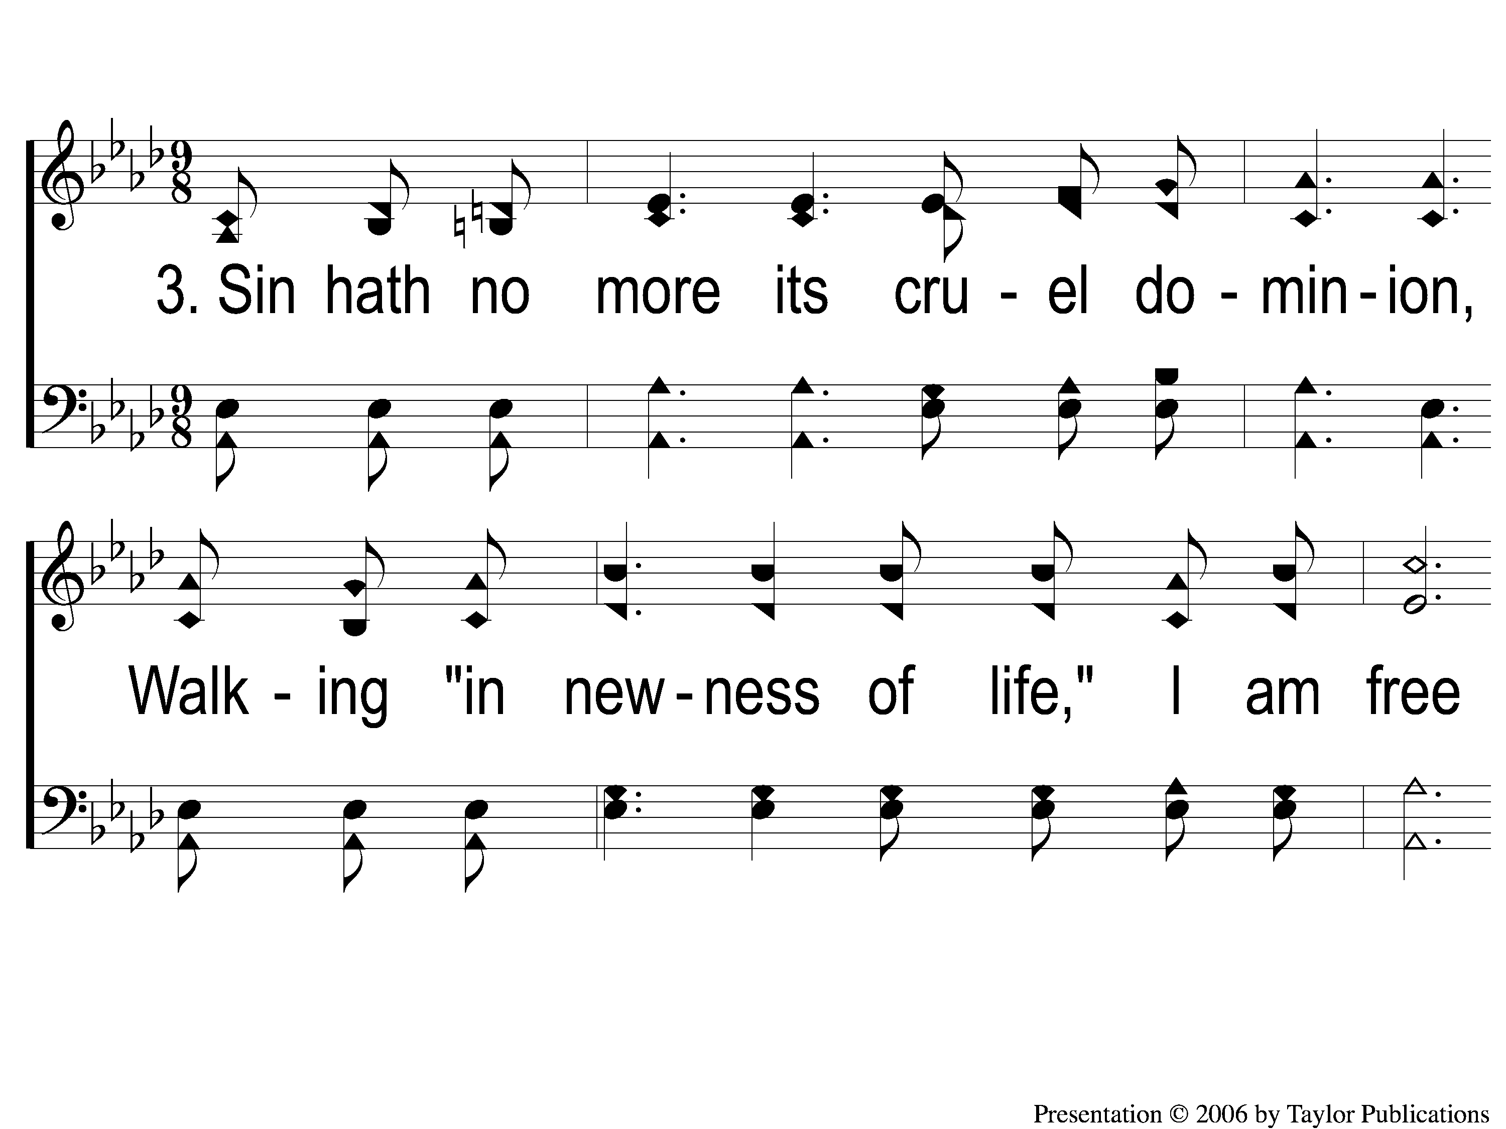
3-1 A New Creature
A New Creature
619

Slide 10
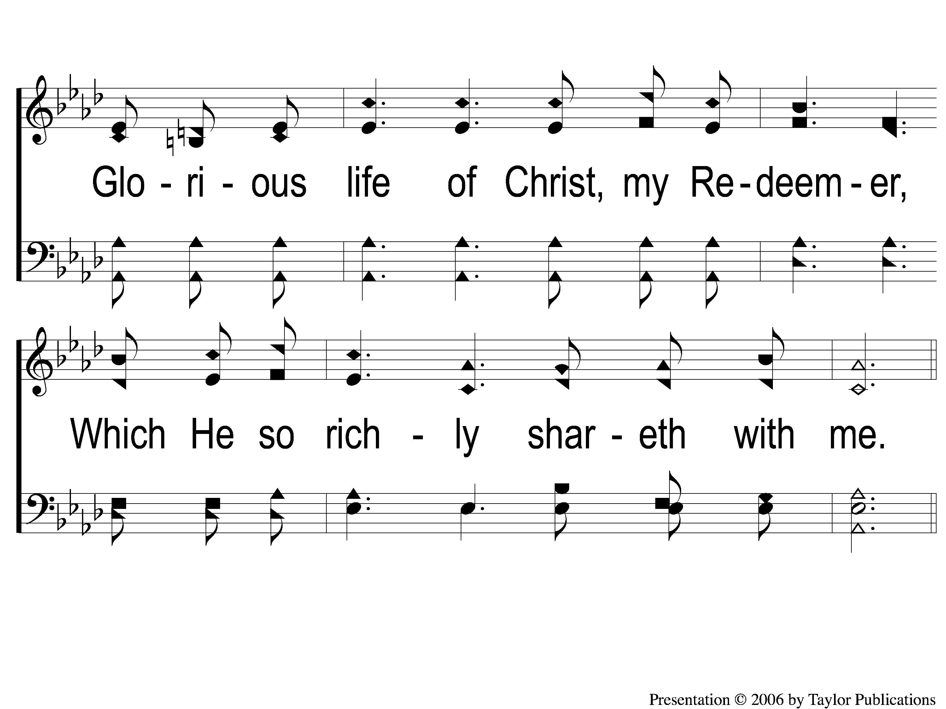
3-2 A New Creature
A New Creature
619

Slide 11
C-1 A New Creature
A New Creature
619

Slide 12
C-2 A New Creature
A New Creature
619

